Slide 1

When To Use What – Microsoft Azure Services
Sastry Kolachina | LinkedIn

Slide 2
Why I created this?
During my conversations with customers and partners, I have been asked many a times to provide a better guidance on “When to Use , What Azure Services” . The idea is to quickly look through some key customer scenarios/use cases and identify relevant Azure solutions to start with. While most of this information is publicly available, it is spread across the Azure documentation and could be difficult to find.
In this deck, I intend to provide guidance on when to use what Azure products/solutions/services/technologies through various decision trees, simple scenario mappings, mind maps etc. The content is sourced from publicly available Azure docs and I have added a bit of my flavours and customisation. I have covered the areas of Compute, Storage, Networking, Security, and Data Platform in this deck.
The content is published at the GitHub repository under MIT license. Feel free to reuse, distribute and add updates to the content. I plan to update every 3-4 months, however, would require the help of the community to keep this updated.
Please, do share your feedback via LinkedIn comments or on GitHub.
GitHub – Please contribute, provide your feedback, suggestions for improvements

Slide 3
Update Log
Last Updated 8 Aug 2021
Reviewed and Updated all the content and diagrams with latest information, tables, and relevant charts/diagrams
Accessibility Checks Done
New Slides
Slide 4: (*New) Added Table of Contents
Slide 15: (*New) Selecting the right Target Storage Service
Slide 16-16: (*New) When to Use What – Azure Network Services
Slide 17-18 (*New) Added Azure Networking Decision Guide
Slide 25-30: (*New) Azure End to End Security, relevant products/solutions/technologies and use cases
Slide 31-33: (*New) Azure Monitoring and Management Tools and Decision Guide
Slide 34: (*New) Decision Tree for Application Security
Slide 44: (*New) Modern Data Architecture and Relevant Azure Services/solutions to Use

Slide 4
Table of Contents
IaaS Decision Making Guide
Security , Identity, Governance and Management
Azure Data Platform
Migration Tools

Slide 5

Azure IaaS (When to Use What) Compute, Network and Storage

Slide 6
Which Azure Compute Product To Use?
If You Want To... | Use This
Provision Linux and Windows virtual machines in seconds with the configurations of your choice | Virtual Machines
Achieve high availability by autoscaling to create thousands of VMs in minutes | Virtual Machine Scale Sets
Get deep discounts when you provision unused compute capacity to run your workloads | Azure Spot Virtual Machines
Build and scale with managed Kubernetes | Azure Kubernetes Service (AKS)
Accelerate app development using an event-driven, serverless architecture | Azure Functions
Develop microservices and orchestrate containers on Windows and Linux | Service Fabric
Quickly create cloud apps for web and mobile with fully managed platform | App Service
Containerize apps and easily run containers with a single command | Container Instances
Cloud-scale job scheduling and compute management with the ability to scale to tens, hundreds, or thousands of virtual machines | Batch
Create highly available, scalable cloud applications and APIs that help you focus on apps instead of hardware | Cloud Services
Deploy your Azure virtual machines on a physical server only used by your organization | Azure Dedicated Host
Notes:
https://azure.microsoft.com/en-us/product-categories/compute/

Slide 7
Selecting Right Cloud Service Model for Infra/Apps Modernization
Objective | Rehost | Refactor | Rearchitect | Rebuild | Cloud model
Deliver new and breakthrough capabilities faster Optimize for developer productivity, build apps faster |  |  |  |  | PaaS
Enable multichannel access, including mobile and IoT Enable secure access to apps and data, on a wide range of devices |  |  |  |  | PaaS
More easily integrate with other web and cloud apps Leverage PaaS, increase productivity with serverless |  |  |  |  | PaaS
Enable business agility with continuous innovation Increase agility across teams and deliver better software, faster |  |  |  |  | PaaS
Meet scalability requirements of existing apps cost effectively Optimize application architecture for cloud scale |  |  |  |  | PaaS
Leverage existing investments Across DevOps, developer tooling, management, infrastructure and app services |  |  |  |  | PaaS
Free up data center space quickly Free up/consolidate resources for apps that must reside on-premises |  |  |  |  | IaaS
Reduce capital expenditure of existing applications Switch to pay-as-you-go model, realize better budget forecasting |  |  |  |  | IaaS
Achieve rapid time to cloud Allow migration with minimal architectural impact |  |  |  |  | IaaS
https://docs.microsoft.com/en-us/azure/architecture/guide/technology-choices/compute-decision-tree

Slide 8
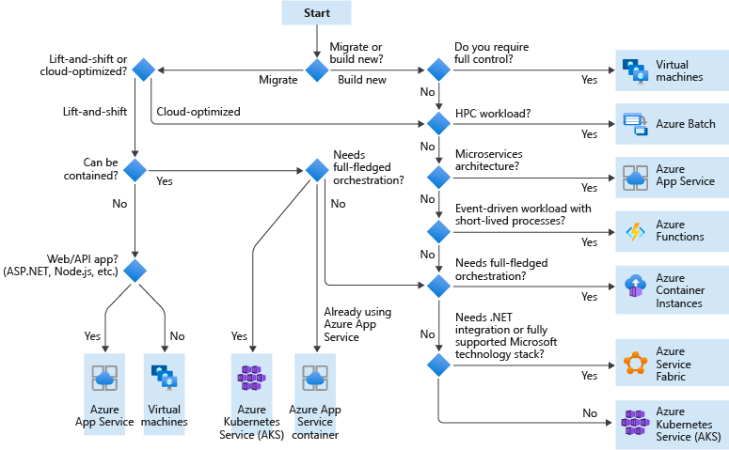
Decision Tree for Compute Service Requirements
Notes:
https://docs.microsoft.com/en-us/azure/cloud-adoption-framework/ready/considerations/compute-options
As part of your landing zone evaluation and preparation, you need to identify all compute resources that your landing zone will need to support. This process involves assessing each of the applications and services that make up your workloads to determine your compute and hosting requirements. After you identify and document your requirements, you can create policies for your landing zone to control what resource types are allowed based on your workload needs.
For each application or service you'll deploy to your landing zone environment, use the following decision tree as a starting point to help you determine your compute services requirements:

Slide 9
Criteria For Selecting An Azure Compute Service (Hosting Model)
Criteria | Virtual Machines | App Service | Service Fabric | Azure Functions | Azure Kubernetes Service | Container Instances | Azure Batch
Application composition | Agnostic | Applications, containers | Services, guest executables, containers | Functions | Containers | Containers | Scheduled jobs
Density | Agnostic | Multiple apps per instance via app service plans | Multiple services per VM | Serverless ¹ | Multiple containers per node | No dedicated instances | Multiple apps per VM
Minimum number of nodes | 1 ² | 1 | 5 ³ | Serverless ¹ | 3 ³ | No dedicated nodes | 1 ⁴
State management | Stateless or Stateful | Stateless | Stateless or stateful | Stateless | Stateless or Stateful | Stateless | Stateless
Web hosting | Agnostic | Built in | Agnostic | Not applicable | Agnostic | Agnostic | No
Can be deployed to dedicated VNet? | Supported | Supported⁵ | Supported | Supported ⁵ | Supported | Not supported | Supported
Hybrid connectivity | Supported | Supported ⁶ | Supported | Supported ⁷ | Supported | Not supported | Supported
https://docs.microsoft.com/en-us/azure/architecture/guide/technology-choices/compute-comparison

Slide 10
Criteria For Selecting An Azure Compute Service (Scalability)
Criteria | Virtual Machines | App Service | Service Fabric | Azure Functions | Azure Kubernetes Service | Container Instances | Azure Batch
Autoscaling | Virtual machine scale sets | Built-in service | Virtual machine scale sets | Built-in service | Not supported | Not supported | N/A
Load balancer | Azure Load Balancer | Integrated | Azure Load Balancer | Integrated | Integrated | No built-in support | Azure Load Balancer
Scale limit¹ | Platform image: 1000 nodes per VMSS, Custom image: 100 nodes per VMSS | 20 instances, 100 with App Service Environment | 100 nodes per VMSS | 200 instances per Function app | 100 nodes per cluster (default limit) | 20 container groups per suscription (default limit) | 20 core limit (default limit).

Slide 11
Criteria For Selecting An Azure Compute Service (Devops)
Criteria | Virtual Machines | App Service | Service Fabric | Azure Functions | Azure Kubernetes Service | Container Instances | Azure Batch
Local debugging | Agnostic | IIS Express, others ¹ | Local node cluster | Visual Studio or Azure Functions CLI | Minikube, others | Local container runtime | Not supported
Programming model | Agnostic | Web and API applications, WebJobs for background tasks | Guest executable, Service model, Actor model, Containers | Functions with triggers | Agnostic | Agnostic | Command line application
Application update | No built-in support | Deployment slots | Rolling upgrade (per service) | Deployment slots | Rolling update | Not applicable

Slide 12
Which Azure Storage Product To Use?
If You Want To... | Use This
High-performance, durable block storage for Azure Virtual Machines | Azure Disk Storage
Massively scalable and secure object storage for cloud-native workloads, archives, data lakes, high-performance computing, and machine learning | Azure Blob Storage
Massively scalable and secure data lake for your high-performance analytics workloads | Azure Data Lake Storage
Simple, secure, and serverless enterprise-grade cloud file shares | Azure Files
Enterprise file storage, powered by NetApp | Azure NetApp Files
Appliances and solutions for data transfer to Azure and edge compute | Data Box
Store unstructured data that is completely tamper-proof and can be cryptographically verified | Microsoft Azure Confidential Ledger
High-performance, durable block storage for Azure Virtual Machines | Azure Disk Storage
Notes:
https://azure.microsoft.com/en-us/product-categories/storage/

Slide 13
Azure Storage - Files vs. Blobs vs. Disks
Feature | Description | When to use
Azure Files | Provides an SMB interface, client libraries, and a REST interface that allows access from anywhere to stored files. | You want to "lift and shift" an application to the cloud which already uses the native file system APIs to share data between it and other applications running in Azure. You want to store development and debugging tools that need to be accessed from many virtual machines.
Azure Blobs | Provides client libraries and a REST interface that allows unstructured data to be stored and accessed at a massive scale in block blobs. Also supports Azure Data Lake Storage Gen2 for enterprise big data analytics solutions. | You want your application to support streaming and random-access scenarios. You want to be able to access application data from anywhere. You want to build an enterprise data lake on Azure and perform big data analytics.
Azure Disks | Provides client libraries and a REST interface that allows data to be persistently stored and accessed from an attached virtual hard disk. | You want to lift and shift applications that use native file system APIs to read and write data to persistent disks. You want to store data that is not required to be accessed from outside the virtual machine to which the disk is attached.
Above table compares Files, Blobs, and Disks, and shows example scenarios appropriate for each

Slide 14
Durability Options for your Storage Needs?
Scenario | Locally redundant storage | Geo-redundant storage | Read Access geo-redundant storage | Zone-redundent storage | Geo Zone Redundant Storage | Read Access Geo Zone Redundant Storage
Node unavailability within a data center | Yes
An entire data center (zonal or non-zonal) becomes unavailable | No | Yes (failover is required) |  | Yes | Yes
A region-wide outage | No | Yes (failover is required) |  | No | Yes (failover is required)
Read access to your data (in a remote, geo-replicated region) in the event of region-wide unavailability | No | No | Yes | No | No | Yes
Designed to provide X% durability of objects over a given year | at least 11 9's | at least 16 9's |  | at least 12 9's | at least 16 9's
Supported storage account types | GPv2, GPv1, Blob |  |  | GPv2
Availability SLA for read requests | At least 99.9% (99% for Cool Access Tier) |  | At least 99.99% (99.9% for Cool Access Tier) | At least 99.9% (99% for cool access tier) |  | At least 99.99% (99.9% for Cool Access Tier)
Availability SLA for write requests | At least 99.9% (99% for Cool Access Tier)
Notes:
https://azure.microsoft.com/en-us/blog/geo-zone-redundant-storage-in-azure-now-in-preview/

Slide 15
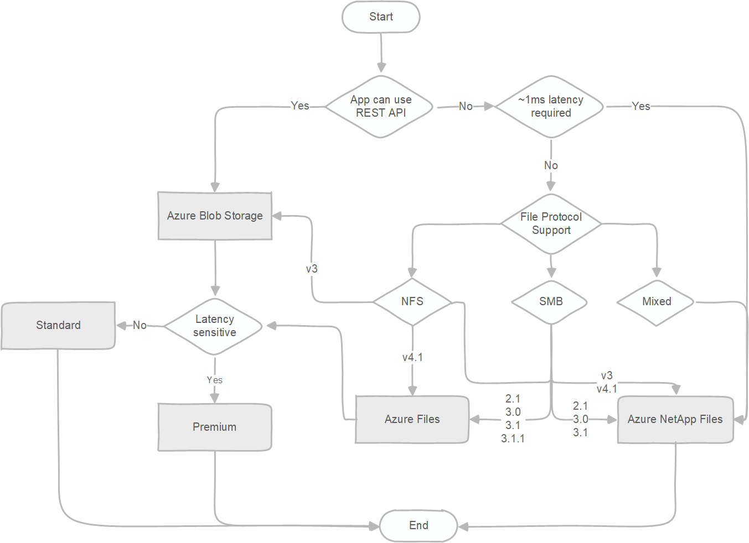
Decision Tree for Azure Storage Service

Slide 16
Which Azure Networking Product To Use?
Secure Network Infrastructure
If You Want To... | Use This
Connect everything from virtual machines to incoming VPN connections | Azure Virtual Network
Balance inbound and outbound connections and requests to applications | Azure Load Balancer
Protect your applications from DDoS attacks | Azure DDoS Protection
Native firewall capabilities with built-in high availability and zero maintenance | Azure Firewall
Manage network security policy and routing centrally | Azure Firewall Manager
Private and fully managed RDP and SSH access to your virtual machines | Azure Bastion
Private access to services hosted on the Azure platform | Azure Private Link
Route incoming traffic for better performance and availability | Traffic Manager
Monitor and diagnose network issues | Network Watcher
Notes:
https://azure.microsoft.com/en-us/product-categories/networking/

Slide 17
…Contd.
On-prem and branch connectivity
If You Want To... | Use This
Add private network connectivity from your corporate network to cloud | Azure ExpressRoute
Connect business offices, retail locations, and sites securely with a unified portal | Azure Virtual WAN
Securely use the internet to access Azure Virtual Networks | Azure VPN Gateway
Choose how your traffic routes between Azure and the Internet | Routing preference
Remote work connectivity
If You Want To... | Use This
Securely use the internet to access Azure Virtual Networks | Azure VPN Gateway
Connect business offices, retail locations, and sites securely with a unified portal | Azure Virtual WAN
Protect your applications from DDoS attacks | Azure DDoS Protection
Notes:
https://azure.microsoft.com/en-us/product-categories/networking/

Slide 18
…Contd.
5G and edge computing |
If You Want To... | Use This
Provide real-time customer experiences with ultra-low-latency edge compute | Azure Edge Zones, Azure Edge Zones with carrier, Azure Private Edge Zones
Secure global app delivery
If You Want To... | Use This
Accelerate the delivery of high-bandwidth content to customers worldwide | Azure CDN
Scalable, security-enhanced delivery point for global, microservice-based web applications | Azure Front Door
Manage traffic to your web applications with a web traffic load balancer. | Azure Application Gateway
Use a firewall service for web apps to help improve web app security | Azure Web Application Firewall
Ensure ultra-fast DNS responses and availability for your domain needs. | Azure DNS
Private access to services hosted on the Azure platform | Azure Private Link
Test how networking infrastructure changes will impact performance | Internet Analyzer
Notes:
https://azure.microsoft.com/en-us/product-categories/networking/

Slide 19
Choose the right Azure Virtual Networking architectures
Question | PaaS-only | Cloud-native | Cloud DMZ | Hybrid | Hub and spoke
Will your workload only use PaaS services and not require networking capabilities beyond those provided by the services themselves? | Yes | No | No | No | No
Does your workload require integration with on-premises applications? | No | No | Yes | Yes | Yes
Have you established mature security policies and secure connectivity between your on-premises and cloud networks? | No | No | No | Yes | Yes
Does your workload require authentication services not supported through cloud identity services, or do you need direct access to on-premises domain controllers? | No | No | No | Yes | Yes
Will you need to deploy and manage a large number of VMs and workloads? | No | No | No | No | Yes
Will you need to provide centralized management and on-premises connectivity while delegating control over resources to individual workload teams? | No | No | No | No | Yes
Notes:
https://docs.microsoft.com/en-us/azure/architecture/cloud-adoption/decision-guides/software-defined-network/index

Slide 20
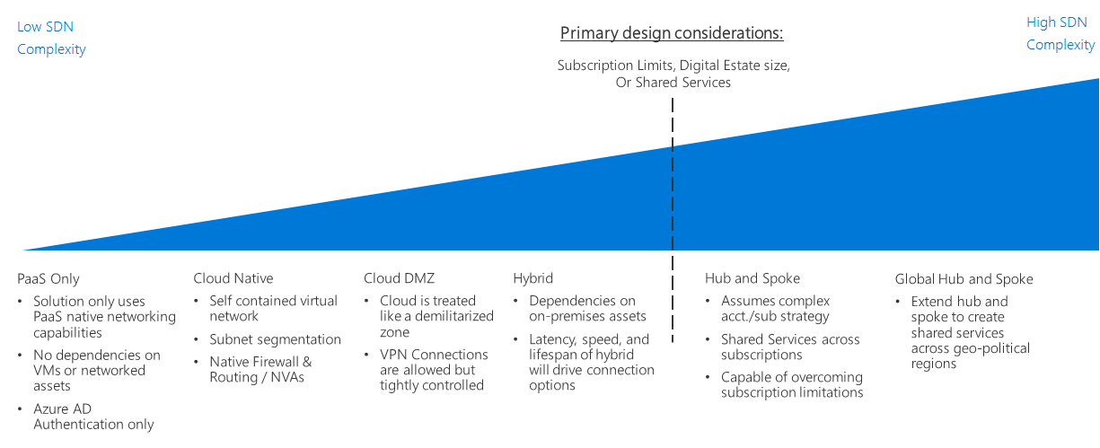
Azure Networking Decision Guide
Notes:
https://docs.microsoft.com/en-us/azure/cloud-adoption-framework/decision-guides/software-defined-network/

Slide 21
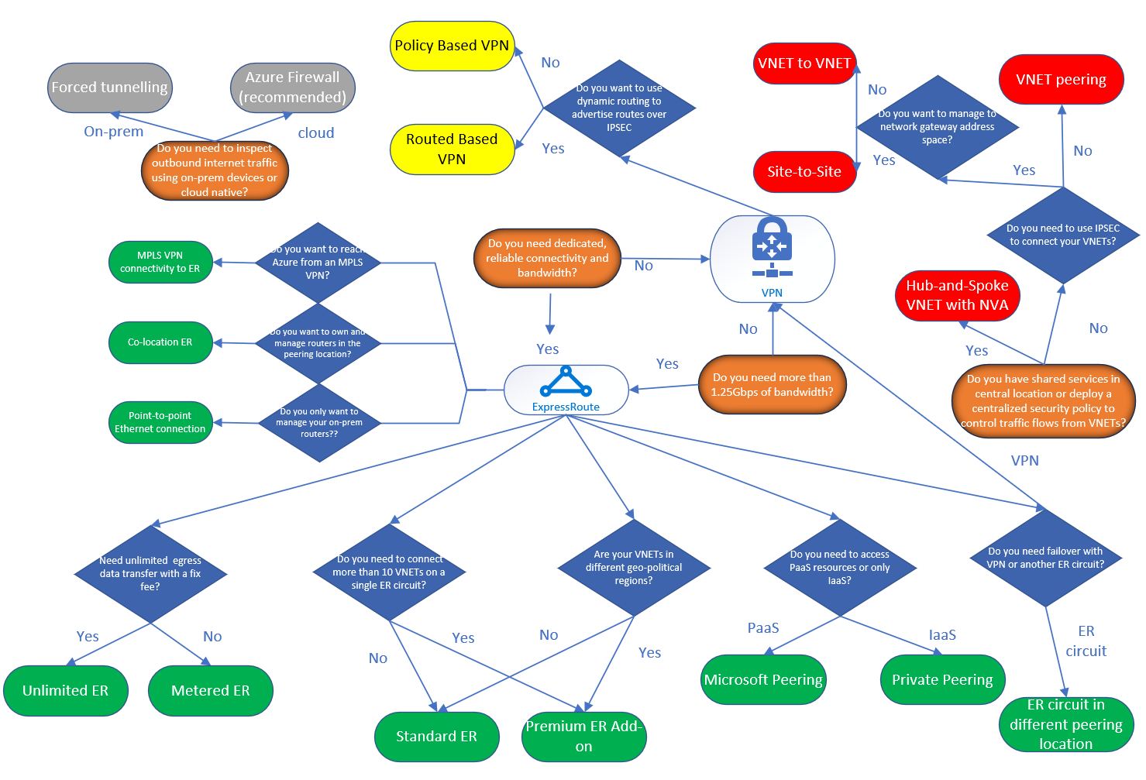
Decision Tree for Azure Networking Solutions
Notes:
https://techcommunity.microsoft.com/t5/ITOps-Talk-Blog/What-is-the-difference-between-Azure-Application-Gateway-Load/ba-p/572912
https://blogs.msdn.microsoft.com/ukhybridcloud/2018/09/12/a-decision-tree-for-azure-networking/

Slide 22
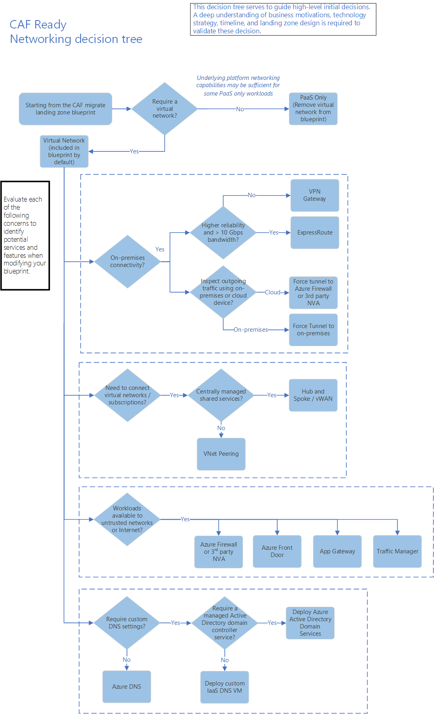
Cloud Adoption Framework– Networking Decision Tree
Notes:
https://docs.microsoft.com/en-us/azure/cloud-adoption-framework/ready/considerations/networking-options

Slide 23
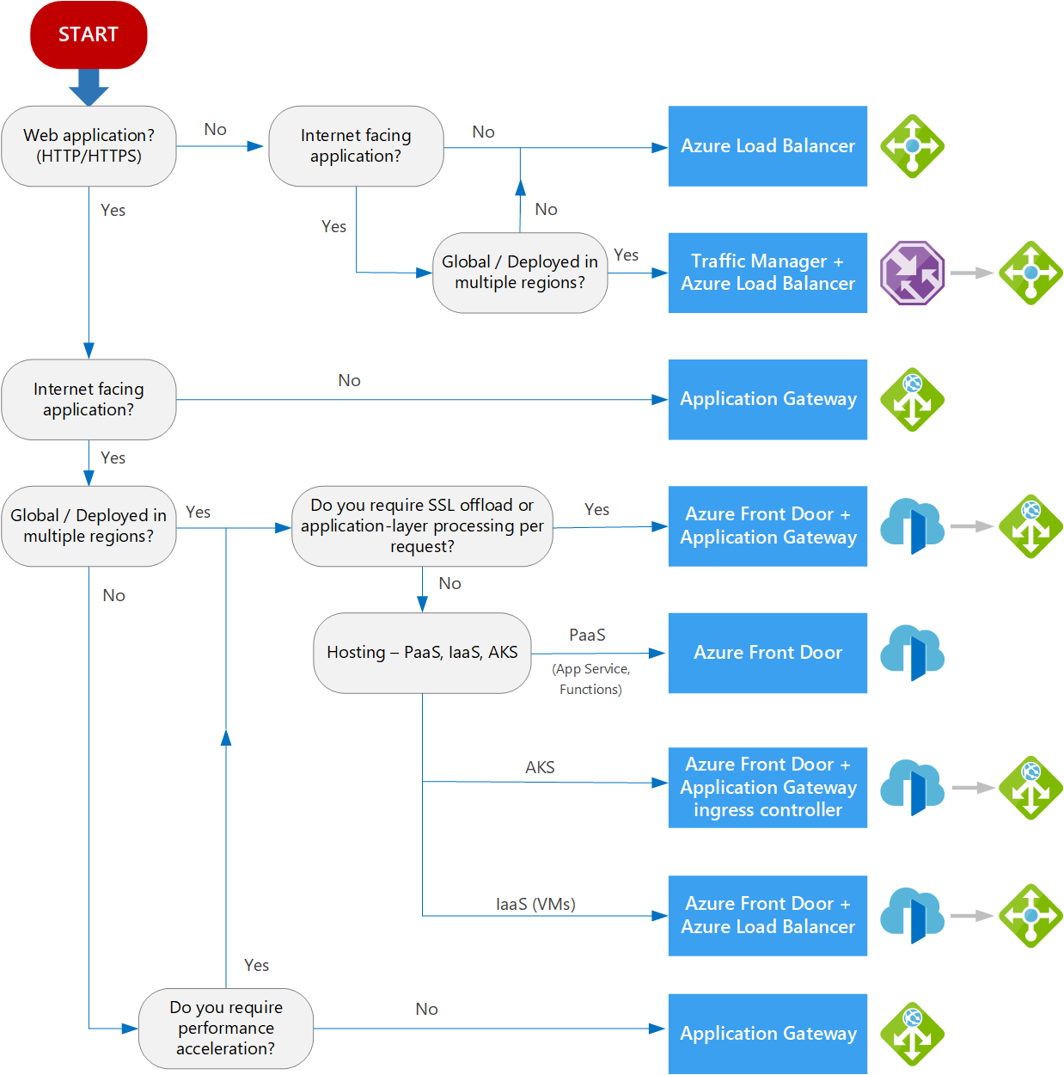
Decision tree for load balancing in Azure
Notes:
https://docs.microsoft.com/en-us/azure/architecture/guide/technology-choices/load-balancing-overview

Slide 24

Security, Identity , Governance and Management

Slide 25
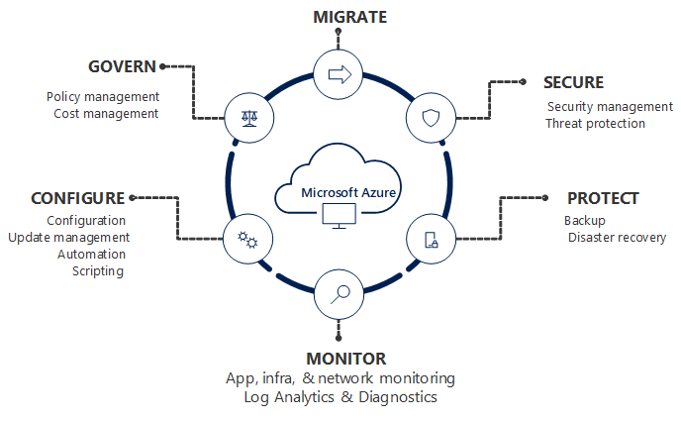
Azure Security, Governance and Management

Slide 26
Which Security Product To Use?
IF YOU WANT TO | USE THIS
Unify security management and enable advanced threat protection for workloads in the cloud and on-premises | Azure Security Center
Safeguard cryptographic keys and other secrets used by cloud apps and services | Key Vault
Protect your Azure resources from denial of service threats | Azure DDoS Protection
Control and help secure email, documents, and sensitive data that you share outside your company | Azure Information Protection
Protect your applications from common web vulnerabilities and exploits with a built-in web application firewall | Application Gateway
A fully managed and unified remote attestation service to validate multiple Trusted Execution Environments (TEEs) in Azure | Microsoft Azure Attestation
Store unstructured data that is completely tamper-proof and can be cryptographically verified | Microsoft Azure Confidential Ledger
Notes:
https://azure.microsoft.com/en-us/product-categories/security/

Slide 27


Securing Business Assets - Relevant Guidance
CEO
Securing Digital Transformation
Business Leadership
Business and Security Integration
CIO
CISO
Cloud Adoption Framework (CAF)
Security Strategy, Programs, and Epics
Technical Leadership
Architecture and Policy
Microsoft Cybersecurity Reference Architectures (MCRA)
Initiative Planning/Execution
Architects & Technical Managers
Azure Security Benchmark
Zero Trust
Privileged Access
Azure Top 10
Technical Planning
Microsoft Security Documentation
Ransomware
Implementation
Product Docs Azure | Microsoft 365
Well Architected Framework (For Azure Workload Owners)
Implementation
Notes:
Key Takeaway: This is a visual depiction of how securing business assets maps to technical implementation and Microsoft security guidance to help you with each step

Slide 28


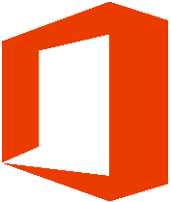









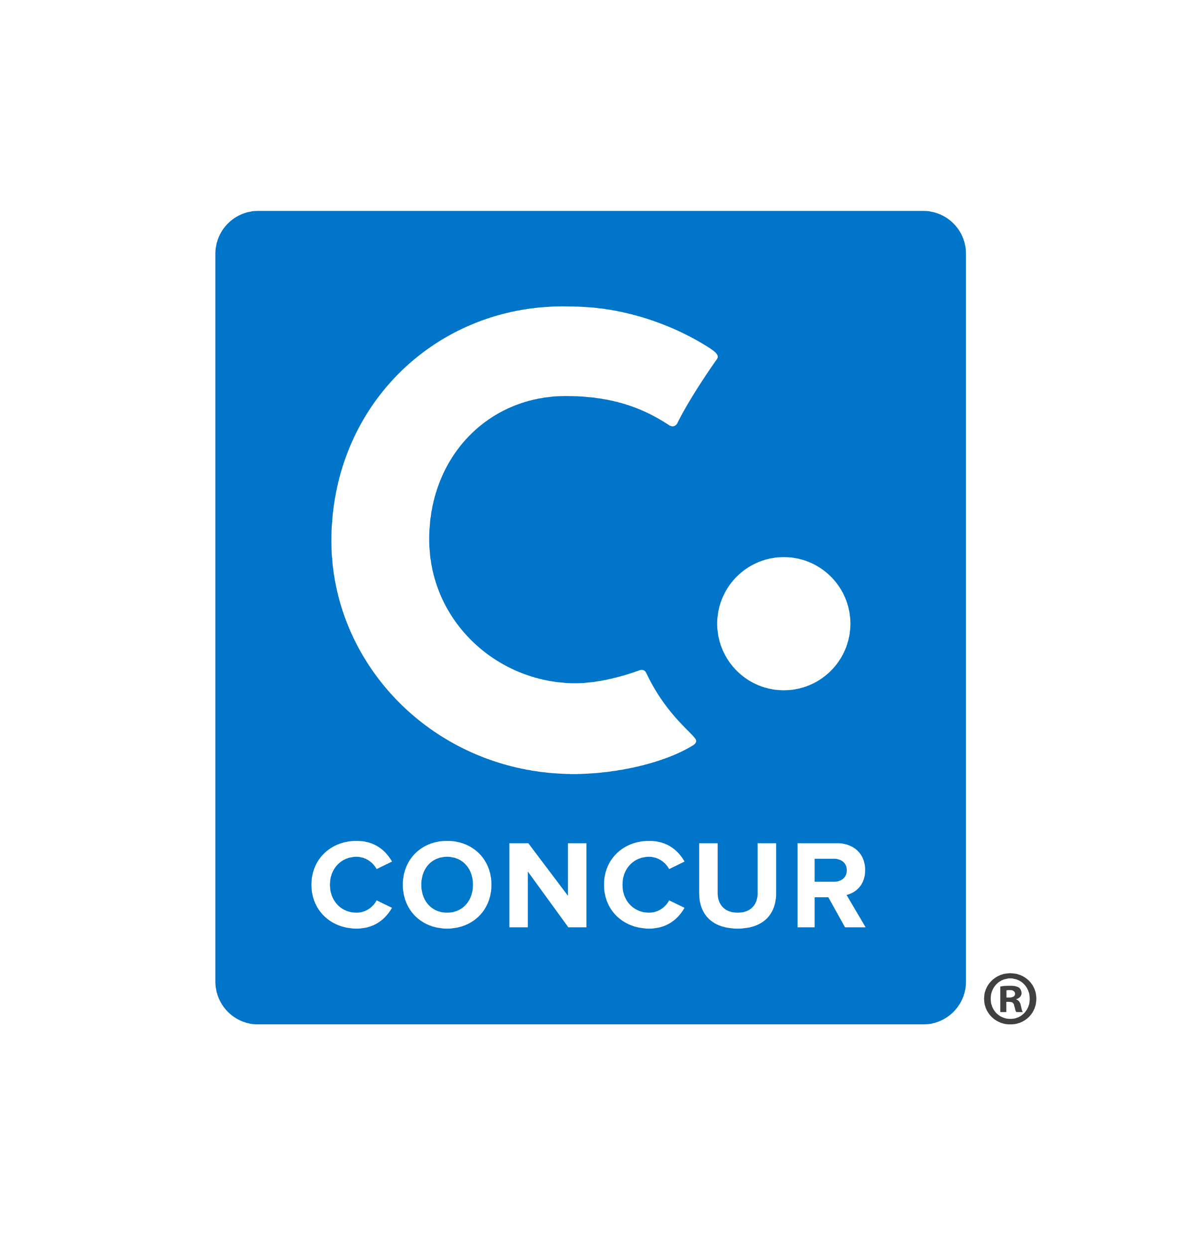


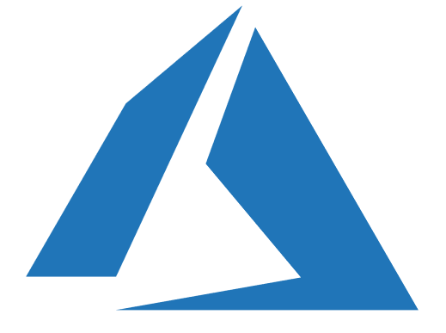



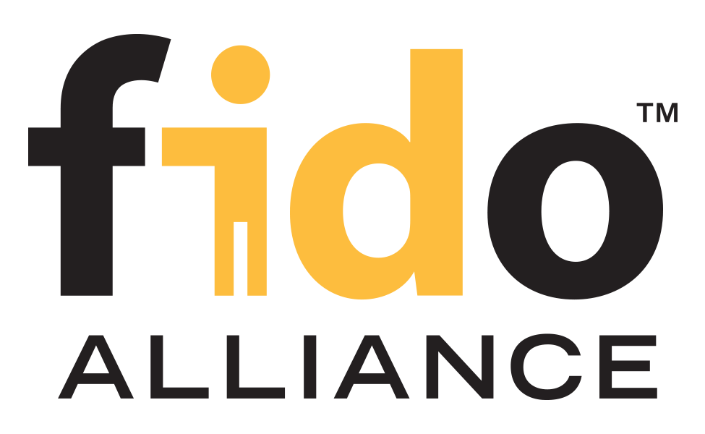

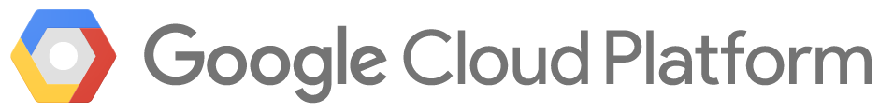





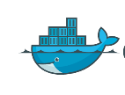
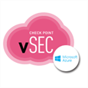



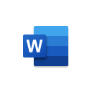
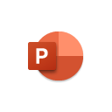
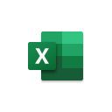
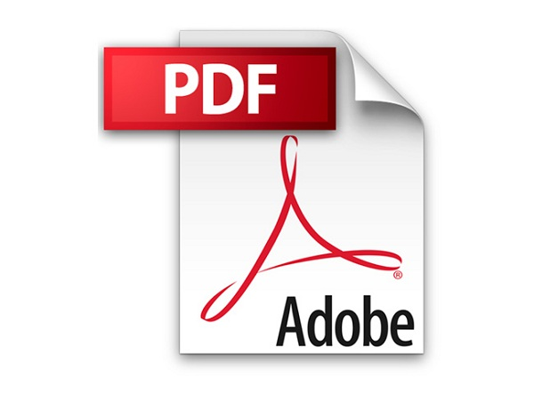









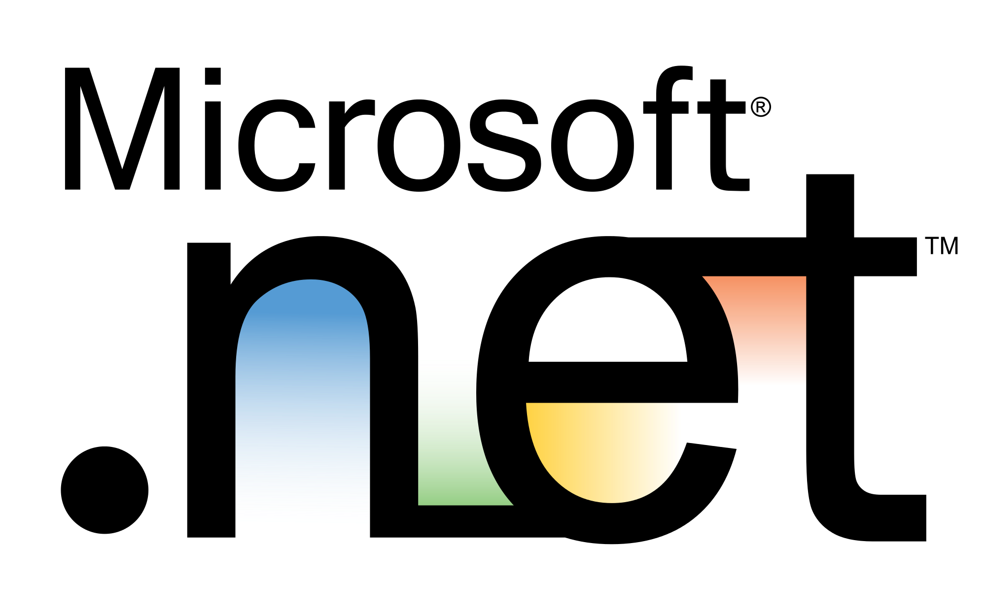
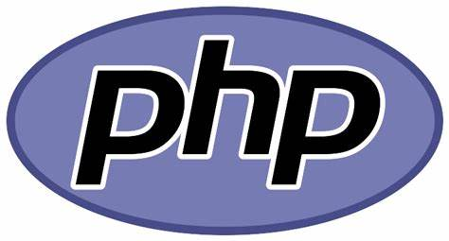

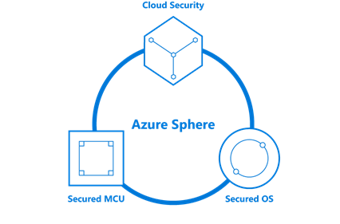

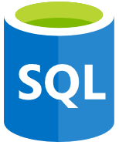

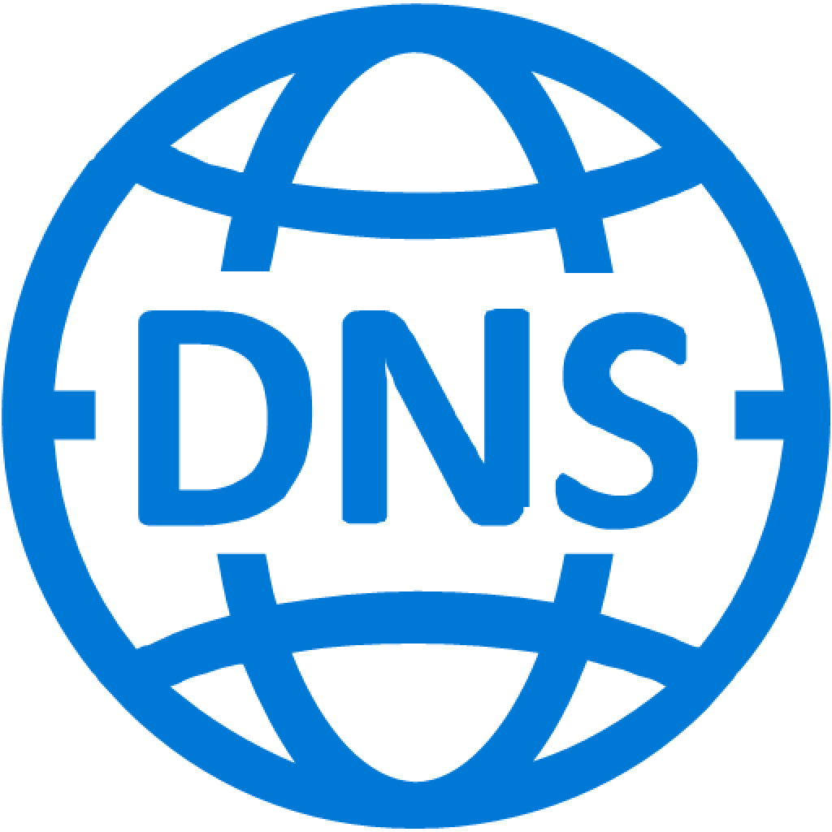

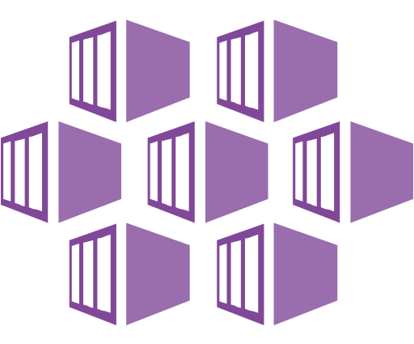
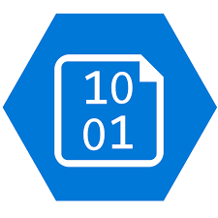
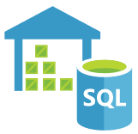
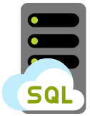

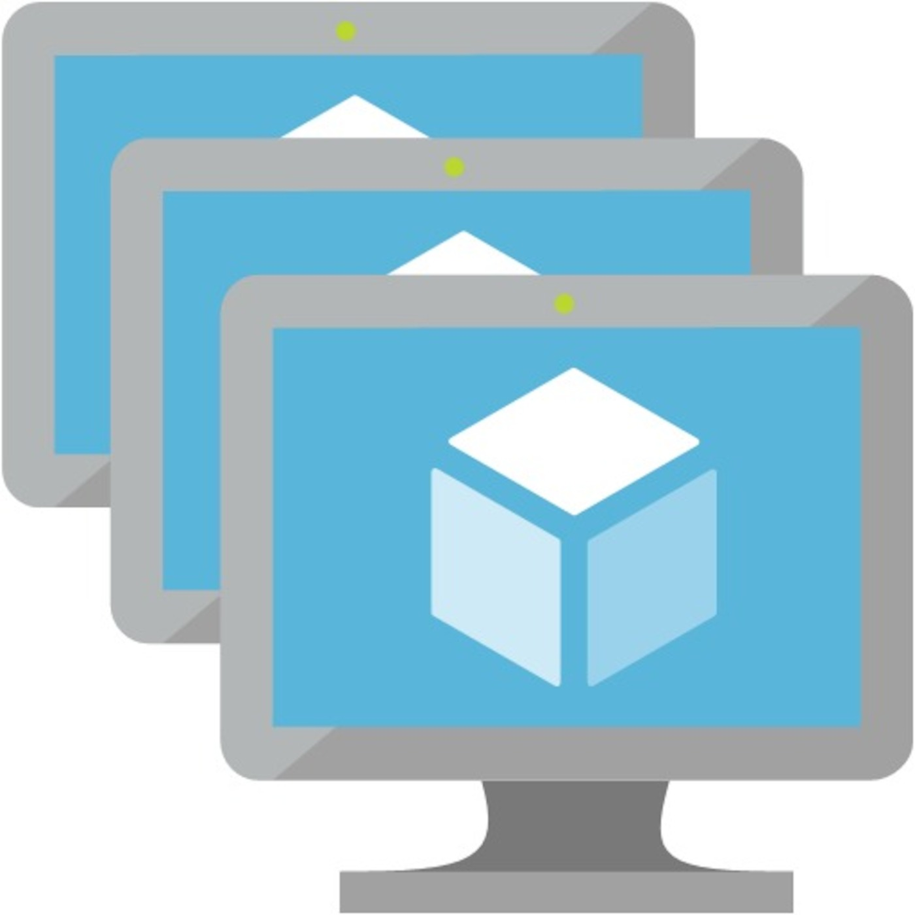
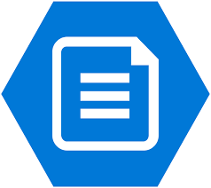


Security Operations / SOC
Software as a Service (SaaS)
Threat Experts
Detection and Response Team (DART)
MSSP/MDR
Microsoft End to End Security Capabilities and Use Cases
(Cybersecurity Reference Architecture)
Microsoft Cloud App Security
App Discovery & Risk Scoring (Shadow IT)
Threat Detection & Response
Policy Audit & Enforcement
Session monitoring & control
Information Protection & Data Loss Prevention (DLP)
Azure Sentinel – Cloud Native SIEM, SOAR, and UEBA for IT, OT, and IoT
Azure & 3rd party clouds
Endpoint
& Server/VM
Office 365
Email and Apps
Identity
Cloud & On-Premises
SaaS
Microsoft Cloud App Security
Other Tools, Logs, and Data Sources
Extended Detection and Response (XDR)
Identity & Access
Azure Defender
Threat & Vulnerability Management
Integrated data classification
Threat analytics on top attacks
Microsoft 365 Defender
Advanced Detection & Remediation | Automated Investigation & Remediation | Advanced Threat Hunting
Conditional Access – Zero Trust Access Control decisions based on explicit validation of user trust and endpoint integrity
Endpoints & Devices
Hybrid Infrastructure – IaaS, PaaS, On-Premises
Information Protection
Azure Active Directory
Microsoft Endpoint Manager
Unified Endpoint Management (UEM)
Azure Security Center – Cross-Platform Cloud Security Posture Management (CSPM)
Azure Purview
Passwordless & MFA
Secure Score
Microsoft Azure
Compliance Dashboard
Microsoft Information Protection (MIP)
Hello for Business
Intune
Configuration Manager
On Premises Datacenter(s)
3rd party IaaS & PaaS
Discover
Protect
Authenticator App
Azure Marketplace
Azure Firewall & Firewall Manager
Monitor
Classify
FIDO2 Keys
NGFW
Classification Labels
Identity Protection
Leaked cred protection
Behavioral Analytics
Extranet
Edge DLP
Azure WAF
File Scanner (on-premises and cloud)
IPS/IDS
DDoS Protection
Azure AD PIM
Microsoft Defender for Endpoint
Unified Endpoint Security
Azure AD App Proxy
Beyond User VPN
Proxy
Express Route
Azure Key Vault
Endpoint Detection & Response (EDR)
S3
Identity Governance
Private Link
Azure Bastion
Data Governance
Azure AD B2B & B2C
Web Content Filtering
Azure Arc
Threat & Vuln Management
Intranet
Azure Lighthouse
Advanced eDiscovery
Defender for Identity
Endpoint Data Loss Protection (DLP)
Azure Stack
Azure Backup
Active Directory
Security & Other Services
Compliance Manager
Securing Privileged Access – Secure Accounts, Devices, Intermediaries, and interfaces to enable and protect privileged users
Privileged Access Workstations (PAWs) - Secure workstations for administrators, developers, and other sensitive users
Microsoft Compliance Score – Prioritize, measure, and plan improvement actions against controls
Microsoft Secure Score – Measure your security posture, and plan/prioritize rapid improvement with included guidance
Windows 10 Security
IoT and Operational Technology (OT)
Azure Defender – Cross-Platform, Cross-Cloud XDR
Multi-asset detection and response for infrastructure and platform as a service (IaaS & PaaS), Proactive Threat defenses
People Security
App control
Exploit protection
Behavior monitoring
Next-generation protection
Network protection
Credential protection
Full Disk Encryption
Attack surface reduction
Azure Sphere
Azure Defender for IoT
Attack Simulator
Insider Risk Management
Communication Compliance
ICS, SCADA, OT
Internet of Things (IoT)
Industrial IoT (IIoT)
Asset & Vulnerability management
Threat Detection & Response
GitHub Advanced Security – Secure development and software supply chain
Threat Intelligence – 8+ Trillion signals per day of security context
Service Trust Portal – How Microsoft secures cloud services
Security Development Lifecycle (SDL)

Slide 29
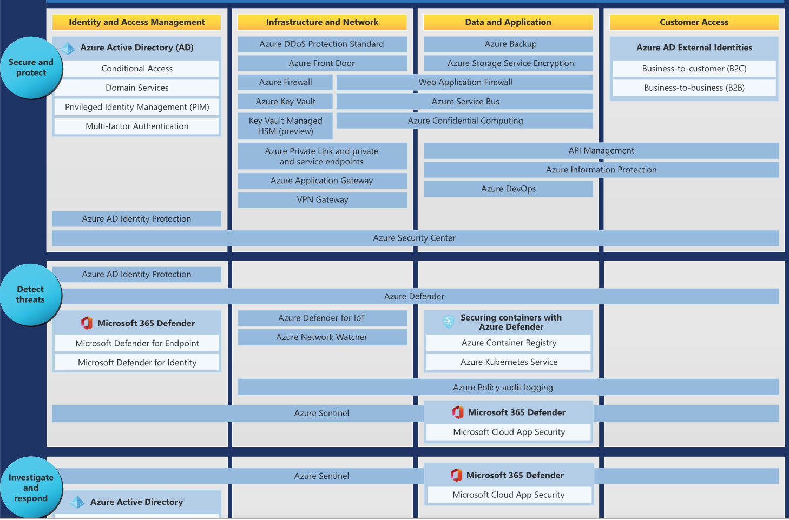
End to End Security Solutions, Technologies, and Platforms

Slide 30

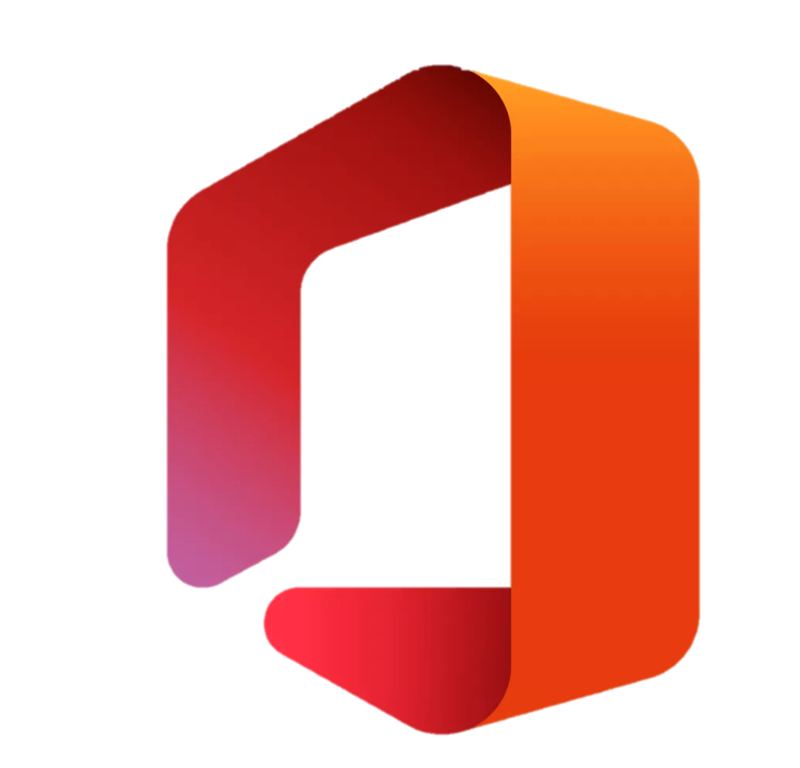



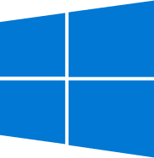

Native Security for Azure – End to End Capabilities and Use Cases
May 2021 – https://aka.ms/MCRA
Azure Cloud Adoption Framework (CAF)
Guidance on security strategy, planning, roles and responsibilities https://aka.ms/CAF
Top 10 Azure Security Best Practices
End-to-End capabilities that apply Zero Trust principles to Infrastructure & Platform as a Service (IaaS & PaaS)
Management Plane Security Platform provided security guardrails, governance, policy, and more
Azure Blueprints
Azure Policy
Management Groups
Role Based Access Control (RBAC)
Azure AD Identity Governance
Azure Security Center
Azure Lighthouse
Resource Locks
Azure Backup & Site Recovery
Governance &
Policy Enforcement
Automated User Provisioning
Entitlement Management
Access Reviews
Privileged Identity Management (PIM)
Terms of Use
Data Plane Security Per-Application/Workload Controls
Enable Zero Trust Networking & Secure Access Service Edge (SASE)
Microsoft Endpoint Manager
Zero Trust Access Control
Explicit trust validation for users and devices before allowing access
Internal Communications (East/West)
External Communications (North/South)
Control
Intune
Azure Well Architected Framework (WAF)
Network/App Security Groups
API Management Gateway
Configuration Manager
Azure AD App Proxy
PrivateLink & Service Endpoints
Azure DDoS and Web Application Firewall (WAF)
Preventive Controls
Azure Bastion
MFA and Passwordless
Azure AD Privileged Identity Management (PIM)
Azure Security Benchmarks (ASB)
Prescriptive Best Practices and Controls
Encryption & Azure Key Vault, Application RBAC Model
Microsoft 365 Defender
Azure AD MFA
Azure AD Identity Protection
Azure Firewall and Firewall Management
Windows Hello
Azure AD Conditional Access
Azure DevOps Security
Full Time Employees, Partners, and/or outsourced providers
Privileged Access Workstation (PAW)
Existing MFA
Microsoft Cloud App Security
GitHub Advanced Security
Business Users
Access Applications
On-Premises & Other Cloud Resources/Data
Azure AD B2C
Developers
CI/CD Pipeline
Application
Customers (and ‘External’ Partners)
Administrators
Azure Active Directory (AD) and B2B
Azure Resource Management (ARM)
On-Premises & Other Cloud Resources/Data
API
App/Service and Automation
Active Directory
Azure Portal
Azure Sphere
Command Line Interface (CLI)
Azure IoT Hub
Internet of Things (IoT) Devices
Automation/API
Existing/Other
‘Internal’ Access
Workstations
Accounts
Identity
Access and Privileges
Interface
Infrastructure
Resource
Network & ‘External’ Access
Microsoft Secure Score
Azure Security Center (ASC) - Risk & Regulatory Compliance Reporting
Risk Factors & Governance
Microsoft 365 Defender
Azure Policy (audit) & Azure resource graph API
Microsoft Defender for Endpoint
Azure AD Identity Protection
Microsoft Defender for Identity
Azure Defender - Detections across assets and tenants
Threat Detection
Azure Sentinel Threat detection, investigation, remediation, and hunting
Microsoft Cloud App Security (MCAS)
Azure WAF Alerts
VMs & Tenants (Azure, On-prem, 3rd party clouds)
Containers and Kubernetes
IoT and Legacy OT Devices (SCADA, ICS, etc.)
Azure SQL & Cosmos DB
Azure Storage Accounts
And More…
Visibility
MCAS Alerts
Azure Firewall Alerts
Security Incident & Event Management (SIEM)
Security Orchestration, Automation, and Remediation (SOAR)
Unified Entity Behavioral Analytics (UEBA)
Machine Learning (ML) & Artificial Intelligence (AI)
Security Data Lake
Azure DDOS Alerts
MCAS Logs
Application Logs
Raw Logs and Signal for Investigation & Hunting
Endpoint logs
Azure AD logs, access logs, alerts, risk scoring
PIM Logs
Network Watcher – IP Flow logs, Packet Capture, Virtual TAP
Azure activity log
Azure Service Diagnostic Logs & Metrics
Notes:
Key Takeaway: Microsoft is simplifying security by providing native security capabilities to secure Azure, our other cloud platforms, and 3rd party cloud platforms
Microsoft focuses both on integrating with security capabilities that customers already have and on simplifying security for organizations by integrating security capabilities into our platforms. This diagram focuses primarily on native controls to show how these can help security professionals spend more of their time and attention on attacks rather than on the challenges of integrating different security technologies together.
In order to provide assurances of confidentiality, integrity, and availability to systems and data, security needs visibility and control:
Visibility – of threats, risk factors and organizational status/compliance with these, and raw activity logs to enable deep investigation and hunting
Control – Governance and enforcement for enterprise policy and standards and preventive controls to block unauthorized access and activities
CLICK 1 – Logging Chapter
For visibility, most customers start by asking us for logs (with the assumption that they can turn them into alerts with a SIEM)
We provide these logs, but we have also learned that it’s very difficult to create high quality alerts fast on a new (unfamiliar) platform with classic approaches like static rules in a SIEM. Because of this, we have invested in providing customers high quality security alerts on assets on Azure.
We have learned that quality really matters because security analysts can waste a massive amount of time and effort investigating false alarms (false positives) and miss out on real attacks (which progress and create more damage while going unnoticed)
Azure Sentinel - In addition to this deep visibility provided by high quality alerts, organizations need a broad view across their estate to correlate what’s happening in Azure to other parts of multi-stage attacks. This drove our investment into create Azure Sentinel with native cloud services to provide an integrated experience for SIEM, SOAR, and UEBA
[Security Information Event Management (SIEM) | Security Orchestration, Automation, and Response (SOAR) | User & Entity Behavior Analytics (UEBA)]
Secure Score - Organizations also need broad visibility into their risk and security posture across their estate. Microsoft has invested into Secure Score to provide this view to help organizations understand top risks, prioritize them, and mitigate them.
CLICK 2 – Protecting Access to Azure
Microsoft 365 Defender (and logs) - We have learned that keeping Azure assets secure requires keeping the identities and devices connecting to Azure secure. We have invested into high quality detection and response systems for endpoints, identity, Office 365, and many other resources (collectively called extended detection and responses – XDR)
Zero Trust Access Control - We take these signals and other best practices into our unified endpoint management (and security) capabilities and into our Zero Trust Access Control strategy that explicit validates trust before granting access to resources in Azure (and also any legacy applications published through Azure AD App Proxy in Azure/on-premises, or Office 365, SaaS apps, etc.)
CLICK 3 – Data Plane Security
This is the traditional approach that most security folks are familiar with. Data Plane security is about protecting workloads individually and in aggregate using network security, Firewalls, host OS security, code security, key management, identity security, web application firewalls, traffic inspection, and the like.
Microsoft has invested in providing both
Support for existing capabilities that organizations have invested into (skills, processes, licensing)
Native capabilities that simplify integration and operation so that your team can focus on attacks and defenses rather than technical integration tasks
Azure Well Architected Framework - Microsoft publishes guidance on architecting workloads focusing on security, performance, cost optimization, reliability and more.
https://aka.ms/WAF
CLICK 4 – Management Plane Security
Management plane Security is a new set of security capabilities that takes advantage of the software defined nature of Azure datacenters (which weren’t possible in physical datacenters). Most folks are aware that the software-defined datacenter model in Azure allows for immediate provisioning of resources (through Azure Resource Manager - ARM), but many don’t realize that this same mechanism allows you to apply security policy, roles, and other controls to workloads
This ambient security in the platform itself allows you to create guardrails for developers and application/workload owners that establish consistent security in your Azure environment.
Azure Security Benchmarks (ASB) [Middle]- Microsoft publishes guidance on architecting workloads focusing on security, performance, cost optimization, reliability and more.
https://aka.ms/BenchmarkDocs
Azure Cloud Adoption Framework (CAF) [Top Right] - Microsoft publishes guidance on overall cloud adoption covering strategy, planning, governance, cost optimization, security, and more.
https://aka.ms/CAF
Additional Notes:
Organizations can reduce privileged attack surface with Infrastructure as Code and secure automation (though they still have to rigorously secure the accounts and systems that have administrative access to the automation)
Organizations can reduce their overall security risk by “shifting left” – directly integrating security into CI/CD pipeline and other automated processes.

Slide 31
Secure Azure Platform – Key Technologies in Play
Compliance
Trust Center
Common Controls Hub
The Cloud Services Due Diligence Checklist
Compliance by service, location & Industry
Secure Platform
Security Development Cycle, Internal audits
Mandatory Security training, background checks
Penetration testing, intrusion detection, DDoS, Audits & logging
State of the art data center, physical security, Secure Network
Security Incident response, Shared Responsibility
Privacy & Controls
Manage your data all the time
Control on data location
Provide data access on your terms
Responding to law enforcement
Stringent privacy standards
Transparency
How Microsoft secures customer data in Azure services
How Microsoft manage data location in Azure services
Who in Microsoft can access your data on what terms
How Microsoft secures customer data in Azure services
Review certification for Azure services, Transparency hub

Slide 32
Azure Management Tools – Which Products to Use?
Management Tools For Monitoring | Use This
Get visibility into the status of Azure platform components | Azure Monitor
Collect, search, and visualize machine data from on-premises and cloud | Log Analytics
Monitor and diagnose network issues | Network Watcher
Management Tools For Governance | Use This
Get transparency into what you are spending on cloud resources | Cost Management + Billing
Set policies across resources and monitor compliance | Azure Policy
Enabling quick, repeatable creation of governed environments | Azure Blueprints
Management Tools For Security And Protection | Use This
Back up your resources and protect against data loss | Azure Backup
Deliver highly available virtual machines with built-in disaster recovery | Azure Site Recovery
Secure your resources and protect against threats | Security Center

Slide 33
…Contd.
Management Tools For Configuration | Use This
Automate, configure, and update your resources | Automation
Get personalized recommendations to help manage your Azure environment | Azure Advisor
Deploy and manage your Azure resources | Azure Resource Manager
Create, maintain, and invoke scheduled work for your apps | Scheduler
Route incoming traffic for better performance and availability | Traffic Manager
Manage Azure using a command-line experience | Cloud Shell
Manage deployed solutions for your customers | Azure Managed Applications
Personalize and manage your Azure environment | Microsoft Azure portal
Stay connected to your Azure resources from anywhere at anytime | Azure mobile app
Empowering service providers to manage customers at scale and with precision | Azure Lighthouse

Slide 34
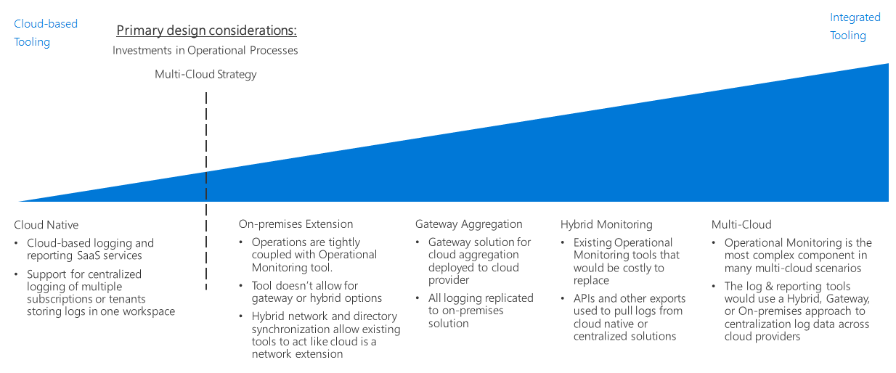
Logging and reporting decision guide
Notes:
https://docs.microsoft.com/en-us/azure/cloud-adoption-framework/decision-guides/logging-and-reporting/

Slide 35
Identity and Access Management – Choosing the Right Product?
If You Want To... | Use This
Provide identity and access management for cloud and hybrid environments | Azure Active Directory
Manage and protect customer identities and access in the cloud using IAM security features | Azure Active Directory B2C
Join virtual machines in Azure to a domain without deploying domain controllers | Azure Active Directory Domain Services

Slide 36
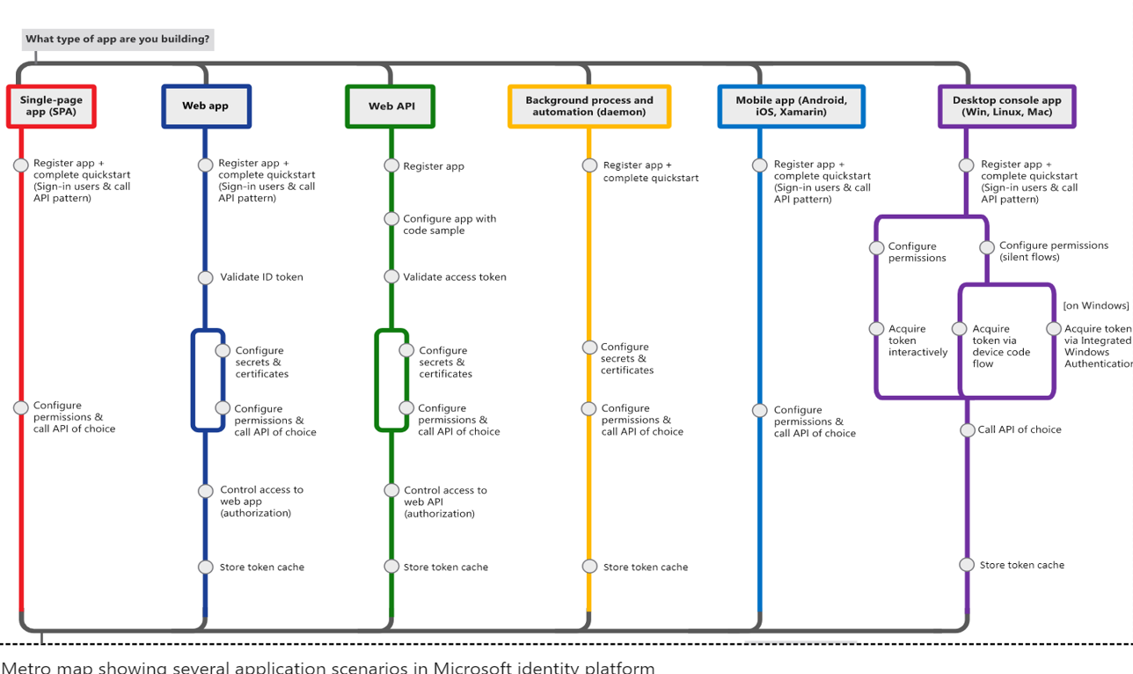
Microsoft Identity Platform

Slide 37
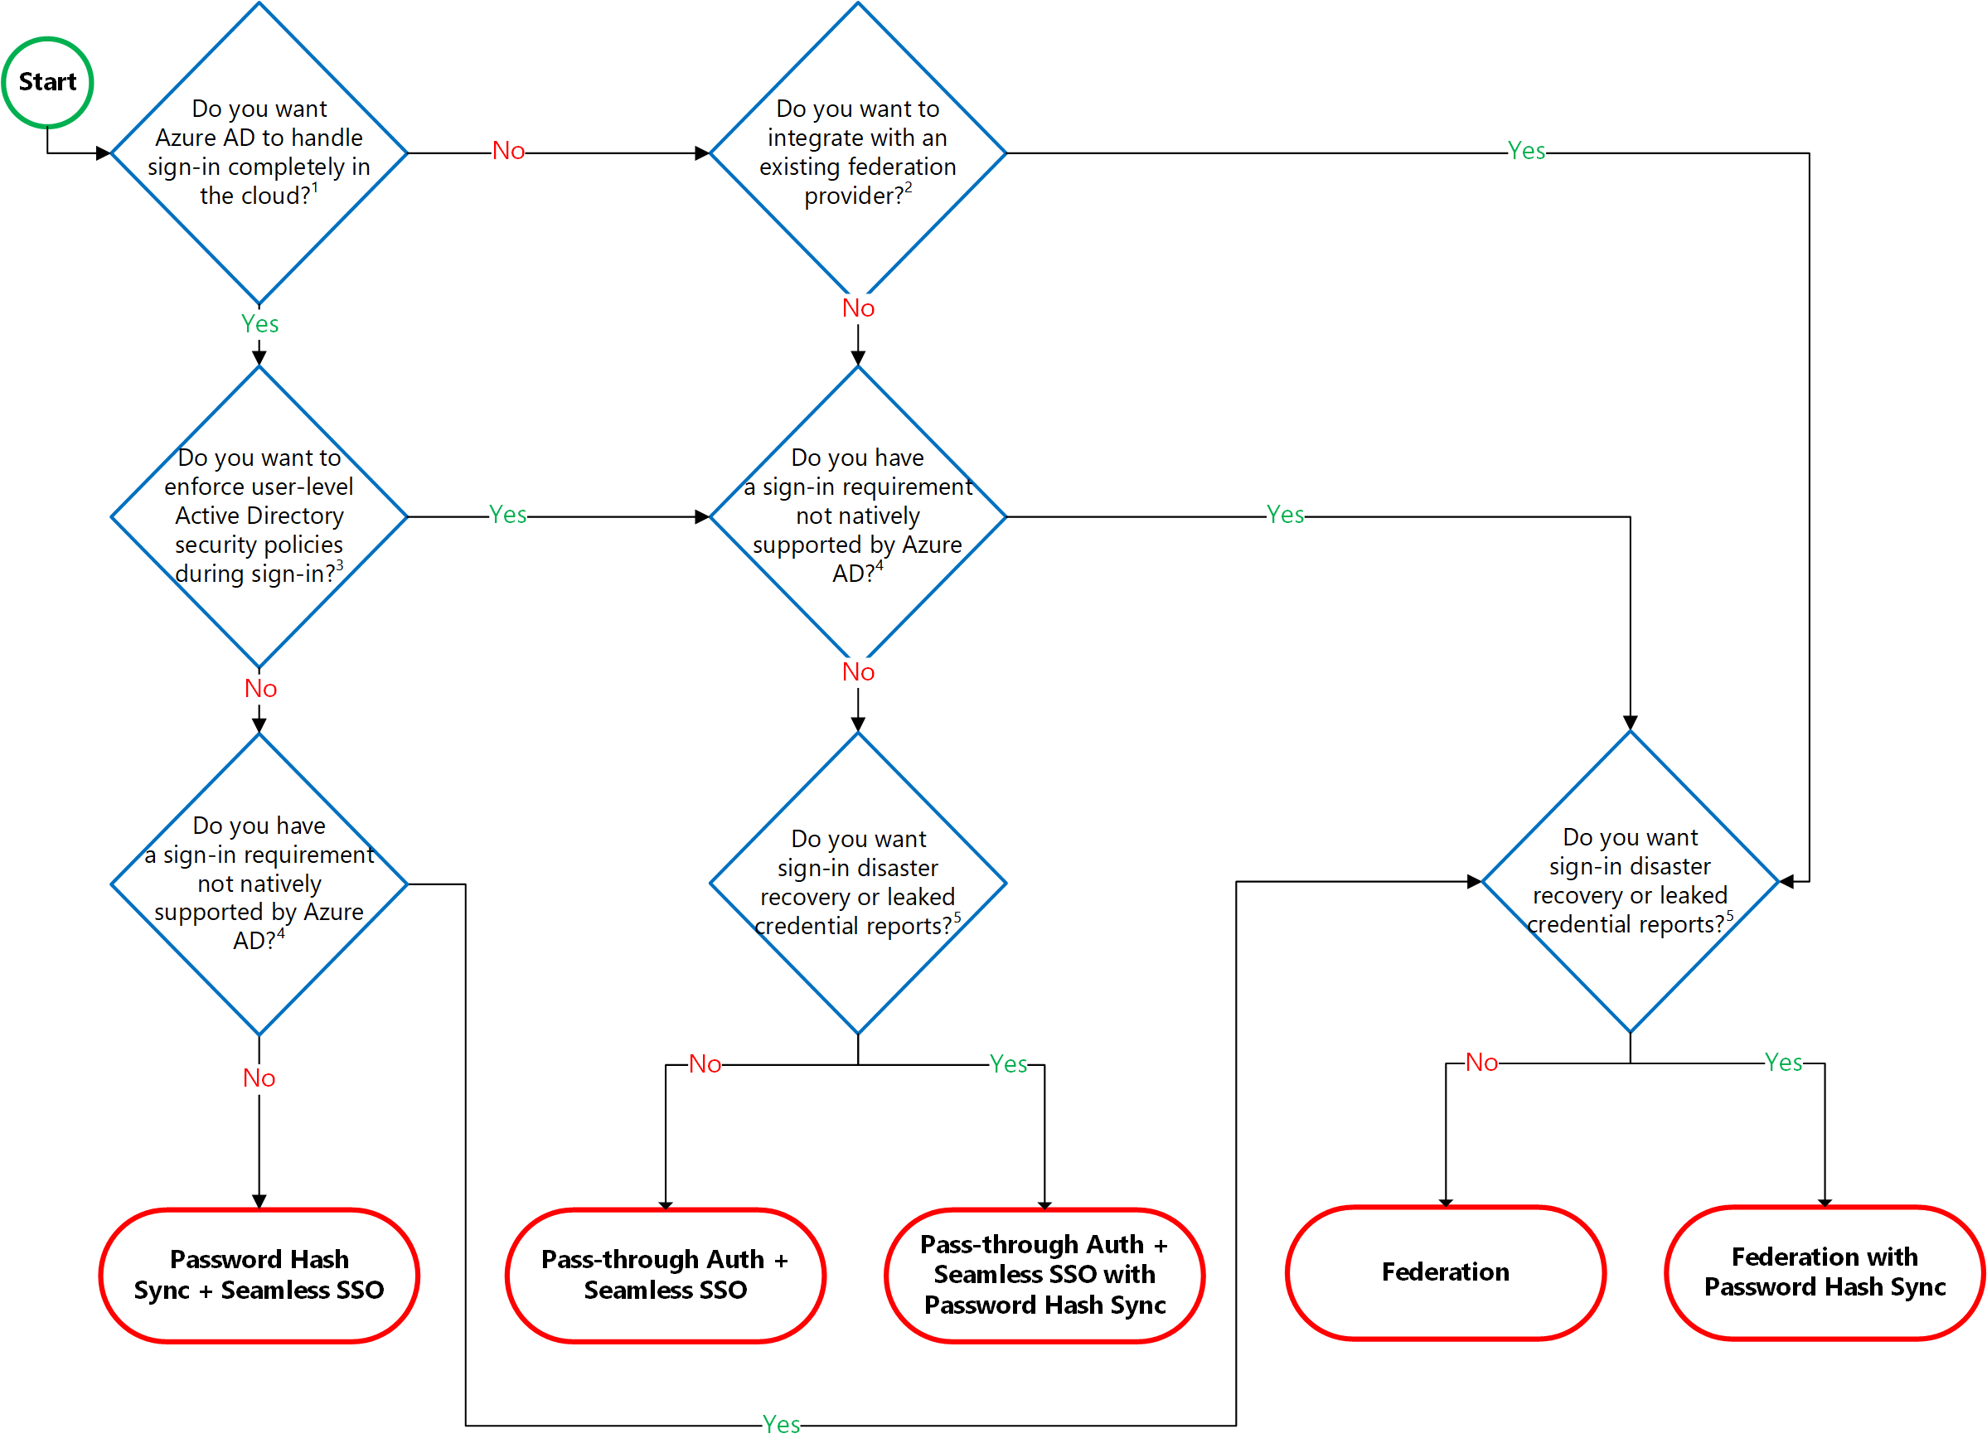
Choosing the Right Authentication Model
Notes:
https://docs.microsoft.com/en-us/azure/active-directory/hybrid/choose-ad-authn
Identity Baseline Tools
https://docs.microsoft.com/en-us/azure/architecture/cloud-adoption/governance/identity-baseline/toolchain
Identity Baseline is one of the Five Disciplines of Cloud Governance. This discipline focuses on ways of establishing policies that ensure consistency and continuity of user identities regardless of the cloud provider that hosts the application or workload.
Selecting Right Auth Model with AAD
https://youtu.be/YtW2cmVqSEw

Slide 38

Azure Data Platform

Slide 39
Which Azure Database Product To Use?
If You Want... | Use This
Build modern cloud applications with an always up-to-date relational database service that includes serverless compute, hyperscale storage, and AI-powered and automated features to optimize performance and durability | Azure SQL Database
Migrate your SQL workloads to Azure while maintaining complete SQL Server compatibility, with all the benefits of a fully managed and evergreen platform as a service | Azure SQL Managed Instance
Migrate your SQL workloads to Azure while maintaining complete SQL Server compatibility and operating system-level access | SQL Server on Virtual Machines
Build scalable, secure, and fully managed enterprise-ready apps on open-source PostgreSQL, scale out single-node PostgreSQL with high performance, or migrate PostgreSQL and Oracle workloads to the cloud | Azure Database for PostgreSQL
Deliver high availability and elastic scaling to open-source mobile and web apps with a managed community MySQL database service, or migrate MySQL workloads to the cloud | Azure Database for MySQL
Deliver high availability and elastic scaling to open-source mobile and web apps with a managed community MariaDB database service | Azure Database for MariaDB
Build applications with guaranteed low latency and high availability anywhere, at any scale, or migrate Cassandra, MongoDB, and other NoSQL workloads to the cloud | Azure Cosmos DB
Power fast, scalable applications with an open-source-compatible in-memory data store | Azure Cache for Redis
Accelerate your transition to the cloud using a simple, self-guided migration process | Azure Database Migration Service
Notes:
https://azure.microsoft.com/en-us/product-categories/databases/

Slide 40
Data Platform Use Case Scenarios and Comparison
 | Azure SQL Database | Azure SQL Managed Instance | SQL Server on Virtual Machines | Azure Database for PostgreSQL | Azure Database for MySQL | Azure Database for MariaDB | Azure Cosmos DB | Azure Cache for Redis
Relational Database | Available | Available | Available | Available | Available | Available
Non-Relational Database (NoSQL) |  |  |  |  |  |  | Available
In-Memory Database |  |  |  |  |  |  |  | Available
Data Models | Relational | Relational | Relational | Relational | Relational | Relational | Multi-Model: Document Wide-column Key-Value Graph | Key-Value
Hybrid | Available | Available | Available | Available (Hyperscale)
Serverless Compute | Available |  |  |  |  |  | Available
Storage Scale Out | Available (Hyperscale) |  |  | Available (Hyperscale) |  |  | Available | Available
Compute Scale Out | Available (Hyperscale - read-only) |  |  | Available (Hyperscale) |  |  | Available | Available
Distributed Multi-Master Writes (Write data to different regions) |  |  |  |  |  |  | Available | Available (Coming Soon)
OSS Based Service (Community edition and open extension support) |  |  |  | Available | Available | Available |  | Available
HTAP (Available with Azure Synapse Link) | Available (Coming Soon) |  |  | Available (Coming Soon) |  |  | Available

Slide 41
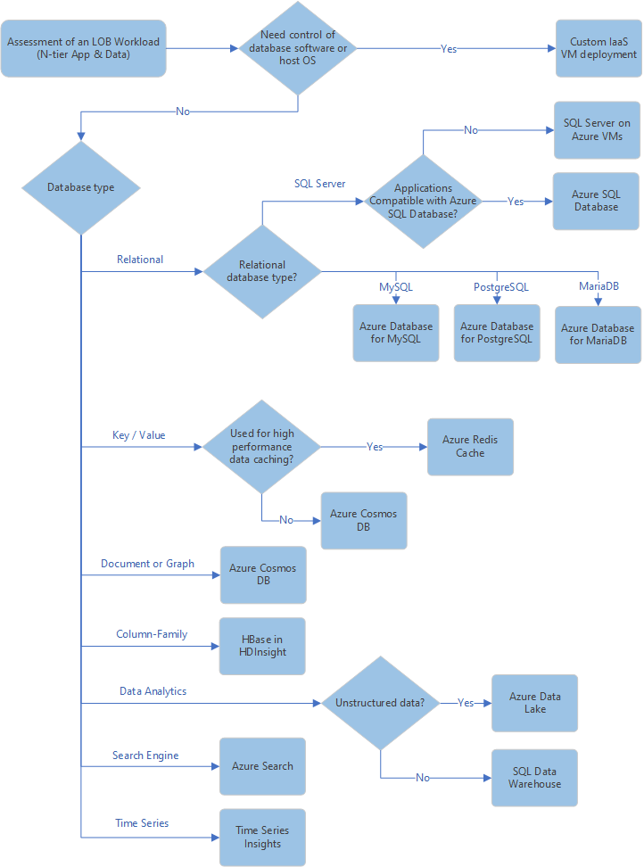
How to Identify data services requirements
Notes:
For each application or service you'll deploy to your landing zone environment, use the following decision tree as a starting point to help you determine the appropriate data store services to use:
https://docs.microsoft.com/en-us/azure/cloud-adoption-framework/ready/considerations/data-options

Slide 42
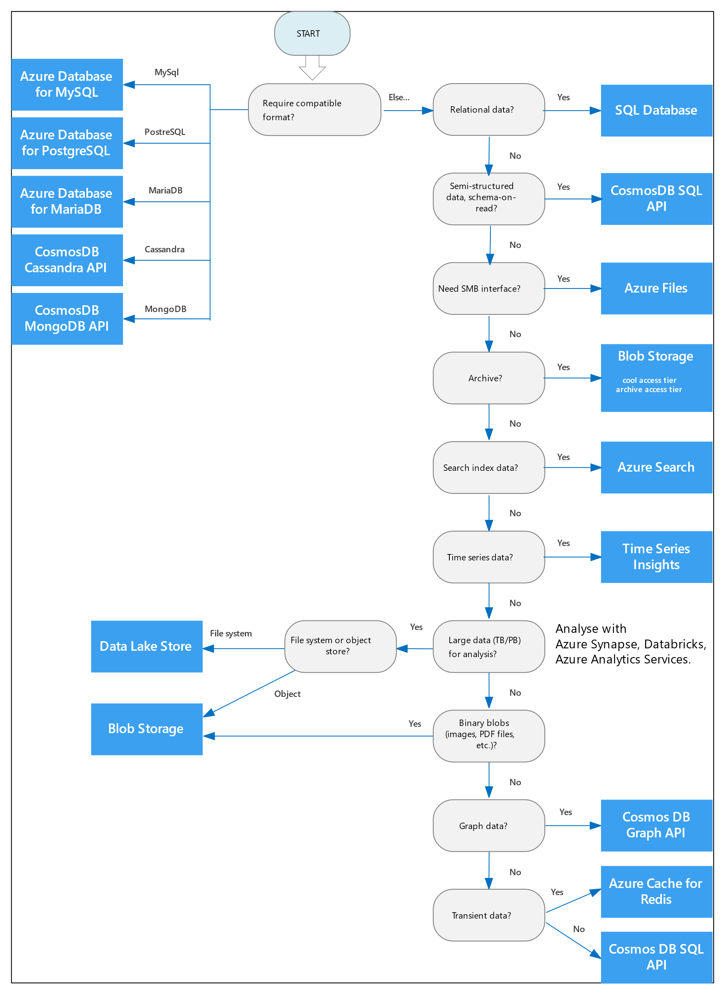
How to Select an Azure data store for your application
Notes:
https://docs.microsoft.com/en-us/azure/architecture/guide/technology-choices/data-store-decision-tree
Azure offers a number of managed data storage solutions, each providing different features and capabilities. This article will help you to choose a data store for your application.
If your application consists of multiple workloads, evaluate each workload separately. A complete solution may incorporate multiple data stores.
Use the following flowchart to select a candidate data store.
https://docs.microsoft.com/en-us/azure/architecture/guide/technology-choices/data-store-decision-tree

Slide 43
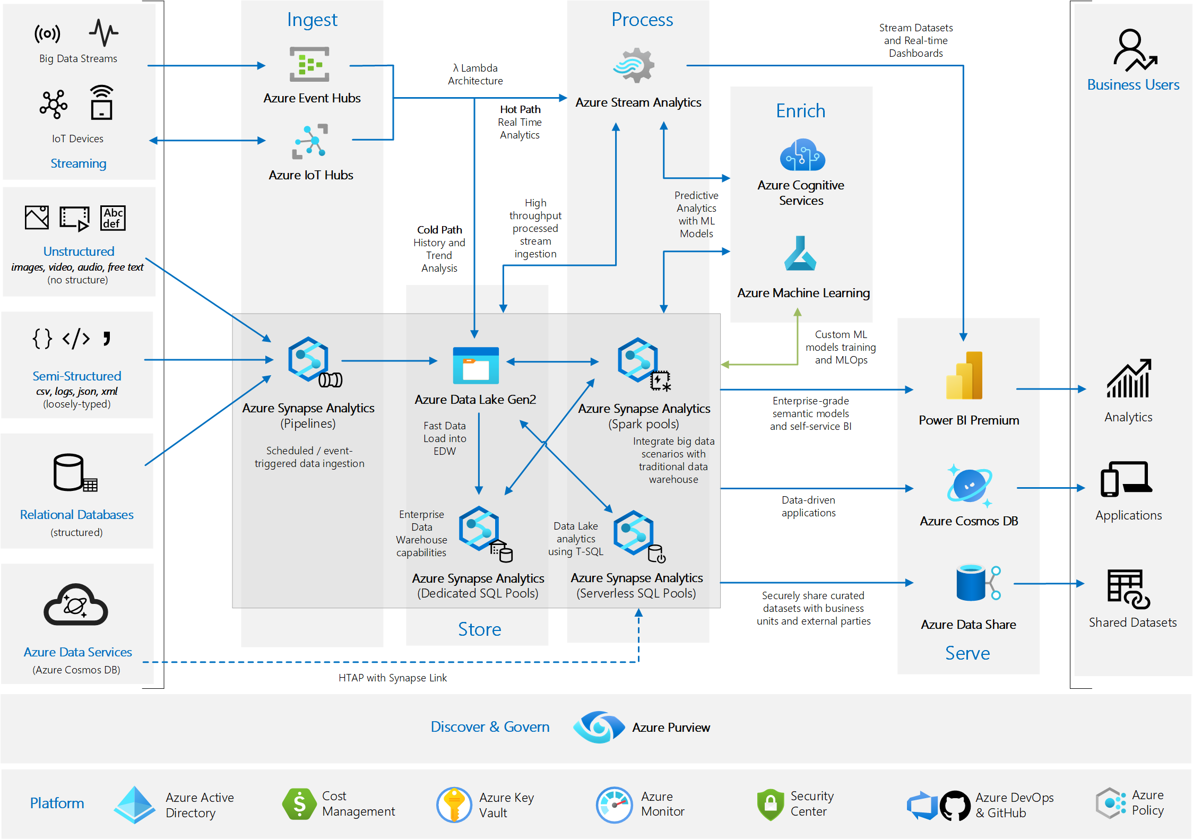
Modern data platform Architecture and Relevant Azure Technologies to Use

Slide 44
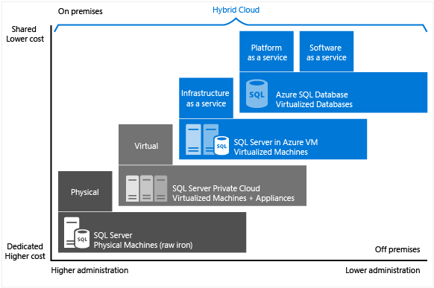
Choose the right SQL Server option in Azure
Choose the right SQL Server option in Azure

Slide 45
Choose the right SQL Server option in Azure
SQL Server on VM | Managed instance in SQL Database | Single database / elastic pool in SQL Database
You have full control over the SQL Server engine. Up to 99.95% availability. Full parity with the matching version of on-premises SQL Server. Fixed, well-known database engine version. Easy migration from SQL Server on-premises Private IP address within Azure Vnet You have ability to deploy application or services on the host where SQL Server is placed | High compatibility with SQL Server on-premises 99.99% availability guaranteed Built-in backups, patching, recovery Latest stable Database Engine version Easy migration from SQL Server Private IP address within Azure Vnet Built-in advanced intelligence and security Online change of resources (CPU/storage). | The most commonly used SQL Server features are available 99.99% availability guaranteed Built-in backups, patching, recovery Latest stable Database Engine version Ability to assign necessary resources (CPU/storage) to individual databases Built-in advanced intelligence and security Online change of resources (CPU/storage).
You need to manage your backups and patches You need to implement your own High-Availability solution There is a downtime while changing the resources(CPU/storage) | There is still some minimal number of SQL Server features that are No guaranteed exact maintenance time (but nearly transparent) Compatibility with the SQL Server version can be achieved only using database compatibility levels. | Migration from SQL Server might be hard Some SQL Server features are No guaranteed exact maintenance time (but nearly transparent) Compatibility with the SQL Server version can be achieved only using database compatibility levels Private IP address cannot be assigned (you can limit the access using firewall rules).
https://docs.microsoft.com/en-us/azure/sql-database/sql-database-paas-vs-sql-server-iaas#business-motivations-for-choosing-azure-sql-database-or-sql-server-on-azure-vms

Slide 46

Migration Tools

Slide 47
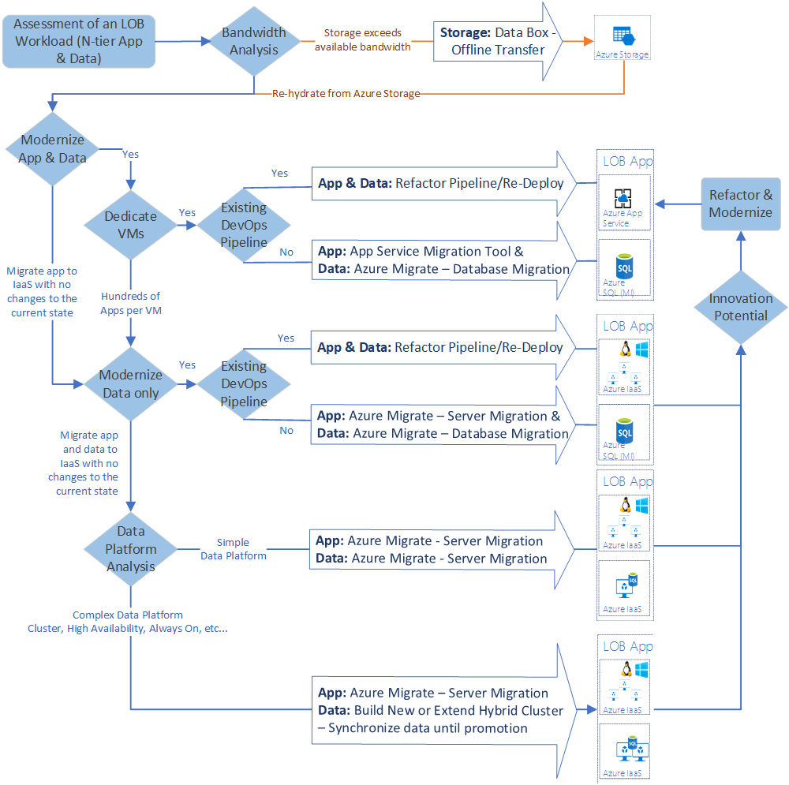
Azure Migration Tools Decision Guide
Notes:
https://docs.microsoft.com/en-us/azure/cloud-adoption-framework/decision-guides/migrate-decision-guide/

Slide 48
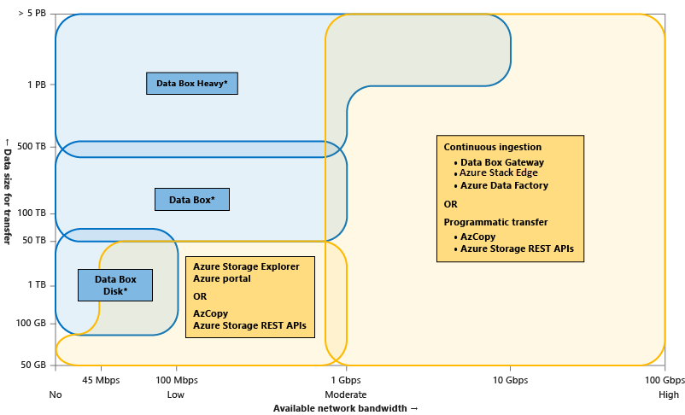
Azure Data Transfer Tools Decision Guide
Notes:
https://docs.microsoft.com/en-us/azure/storage/common/storage-choose-data-transfer-solution

Slide 49
Selecting the Right Offline Data Transfer Solutions
 | Data Box Disk | Data Box | Data Box Heavy | Import/Export
Data size | Up to 35 TBs | Up to 80 TBs per device | Up to 800 TB per device | Variable
Data type | Azure Blobs | Azure Blobs Azure Files | Azure Blobs Azure Files | Azure Blobs Azure Files
Form factor | 5 SSDs per order | 1 X 50-lbs. desktop-sized device per order | 1 X ~500-lbs. large device per order | Up to 10 HDDs/SSDs per order
Initial setup time | Low (15 mins) | Low to moderate (<30 mins) | Moderate (1-2 hours) | Moderate to difficult (variable)
Send data to Azure | Yes | Yes | Yes | Yes
Export data from Azure | No | No | No | Yes
Encryption | AES 128-bit | AES 256-bit | AES 256-bit | AES 128-bit
Hardware | Microsoft supplied | Microsoft supplied | Microsoft supplied | Customer supplied
Network interface | USB 3.1/SATA | RJ 45, SFP+ | RJ45, QSFP+ | SATA II/SATA III
Partner integration | Some | High | High | Some
Shipping | Microsoft managed | Microsoft managed | Microsoft managed | Customer managed
Use when data moves | Within a commerce boundary | Within a commerce boundary | Within a commerce boundary | Across geographic boundaries, e.g. US to EU
https://docs.microsoft.com/en-us/azure/storage/common/storage-solution-large-dataset-moderate-high-network

Slide 50
Selecting the Right Online Data Transfer Solutions
 | Tools AzCopy, Azure PowerShell, Azure CLI | Azure Storage REST APIs, SDKs | Data Box Gateway or Data Box Edge | Azure Data Factory
Data type | Azure Blobs, Azure Files, Azure Tables | Azure Blobs, Azure Files, Azure Tables | Azure Blobs, Azure Files | Supports 70+ data connectors for data stores and formats
Form factor | Command-line tools | Programmatic interface | Microsoft supplies a virtual or physical device | Service in Azure portal
Initial one-time setup | Easy | Moderate | Easy (<30 minutes) to moderate (1-2 hours) | Extensive
Data pre-processing | No | No | Yes (With Edge compute) | Yes
Transfer from other clouds | No | No | No | Yes
User type | IT Pro or dev | Dev | IT Pro | IT Pro
https://docs.microsoft.com/en-us/azure/storage/common/storage-solution-large-dataset-moderate-high-network

Slide 51
Selecting the Right Tool for Database Migration to Azure
Tool | Description
Configuration Manager | Use SQL Server Configuration Manager to configure SQL Server services and configure network connectivity. Configuration Manager runs on Windows
Database Experimentation Assistant | Use Database Experimentation Assistant to evaluate a targeted version of SQL for a given workload.
Data Migration Assistant | The Data Migration Assistant tool helps you upgrade to a modern data platform by detecting compatibility issues that can impact database functionality in your new version of SQL Server or Azure SQL Database.
Distributed Replay | Use the Distributed Replay feature to help you assess the impact of future SQL Server upgrades. Also use Distributed Replay to help assess the impact of hardware and operating system upgrades, and SQL Server tuning.
SQL Server Migration Assistant | Use SQL Server Migration Assistant to automate database migration to SQL Server from Microsoft Access, DB2, MySQL, Oracle, and Sybase.

Slide 52
Useful Links
Azure Introduction – Tenants, Subscriptions, Guidance on Naming Conventions, IP Addressing, Important facts to understand before planning your virtual DC
Getting started with Microsoft Azure security – How Azure Stores Customer Info in various PaaS, IaaS and other scenarios
Azure subscription and service limits, quotas, and constraints
List of supported software on Azure
Azure Pricing Calculator (Channel Partners, Customers)
Monitoring
Sources of monitoring data in Azure
Collecting monitoring data in Azure
Multi-customer monitoring with Azure Log Analytics (MSPs/Service Providers)
*Refer to the notes section for important facts on Azure , will be useful for planning your virtual DC
Notes:
Mesh and Hub-and-Spoke Networks on Azure: Architectural Considerations for Virtual Network Peering
Microsoft Azure Datacenter IP Ranges Microsoft Public IP Space Network infrastructure requirements for Microsoft Intune Power BI and ExpressRoute Office 365 URLs and IP address ranges Managing ExpressRoute for Office 365 connectivity Office 365 Network Connectivity Principles
Managing Office 365 End Points: https://support.office.com/en-us/article/managing-office-365-endpoints-99cab9d4-ef59-4207-9f2b-3728eb46bf9a?ui=en-US&rs=en-US&ad=US#ID0EACAAA=0._Overview

Slide 53
Update Log
Last Updated 22 Jan 2021
Reviewed and updated slides for IaaS, updated relevant charts/diagrams
Updated Management, Monitoring and Governance section
New Slides
Slide 6 – (*New) Decision Tree – Identify Compute Service Requirements
Slide 18 – (*New) Cloud Adoption Framework – Networking Decision Tree
Slide 19 – Networking - Updated with latest chart
Slide 24 – (*New) Security - Which Feature to Use to Secure Azure Platform
Slide 26-27 – App Modernization – Selecting Right Cloud Services
Slide 29 – Updated Data Platform Product – When to Use What
Slide 30 – (*New) Data Platform Use Case Scenarios and Comparison
Slide 32 – (*New) Select an Azure data store for your application (Thanks Anil and Husam)

Slide 54
Update Log
Last Updated: 02 Sep 2019
Reviewed and Updated product slides for IaaS
New Slides
Slide 11 - Storage Durability
Slide 15 - Choose the right virtual networking architectures
Slide 27: Choosing a Data Store
Slide 28 - 32: Azure Data Migration Tools

Slide 55
Update Log
Last Updated 26 Mar 2019
Reviewed and updated slides for IaaS
Added Azure Data Platform as a separate section
Updated Networking section
Updated Management, Monitoring and Governance section
New Slides
Slide 9 – Selection Criteria for DevOps workloads
Slide 17 – Load Balancer Decision Tree (Thanks to @mvark – github)
Slide 30 – Updated Decision Tree for Azure Migration Tool
Slide 35 – SQL Server Migration to Azure – Tools
Slide 38 – Azure Messaging Services
Notes:
https://docs.microsoft.com/en-in/azure/azure-monitor/overview

